Slide 1
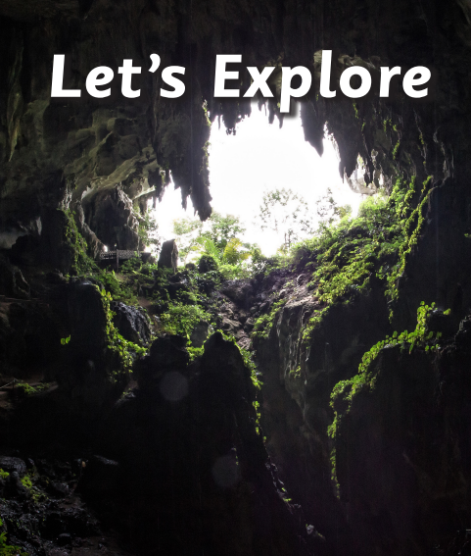
Personal, Social and Emotional Development
This half term we will think about what is special about ourselves and others in our class as well as how we can play and work well together. We will talk about what we want to learn and set ourselves goals.
Literacy
In our phonics lessons we will begin to learn the Phase 2 sounds in the Little Wandle phonics scheme. We will learn that letters make sounds and that we can blend the sounds together to read words.. During our mark making and writing sessions we will talk about what our writing says and begin to write some our newly learnt sounds. We will also be practicing to write our name and how to form lowercase letters correctly.
In reading we will also be following the Little Wandle scheme to deliver daily group reading sessions, starting with wordless books which we will send home for your child to share with you.
During our daily story time sessions and literacy inputs we will read a range of books including ’We’re going on a bear hunt’ ‘Harold and the purple crayon’ and ‘Where the wild things are’
Physical Development
In our PE lesson every Friday with Mr Slaney we will be developing our agility, balance and co-ordination through a Multi Skills program. Please ensure your child has their PE kit in school with appropriate footwear as sessions will be outside weather permitting.
Mathematics
This half term we will focus on ccomparing two small groups of up to five objects,
saying when there are the same number of objects in each group We will match sort and compare objects based on size, capacity and mass. We will also develop our counting skills through songs and the use of real life objects in our everyday play
Expressive Arts and Design
We will think about the buildings in our local environment as well as our own homes by describing their features and functions. We will then use a selection of construction materials, both small and large, to create dens, houses and other buildings.
During our music sessions we will explore a range of musical instruments to help us retell the Story ‘We’re going on a bear hunt’ We will also learn lots of new songs and rhymes during our daily singing sessions
Our topic in the Hedgehog class this half term is ‘Let’s explore’ It teaches children about the environments that they share with others, including their homes, school and places in the local community.
Understanding the World
Over the coming weeks we will explore our school community as well as the local community. We will go on a walk around the village and talk about what we see.. We will explore maps by creating our own and follow them when we are out exploring. Towards the end of the half term we will look at the changing season and signs of Autumn as we prepare for our Harvest service at the local church.
Forest school
During our regular Friday afternoon forest school session we will be exploring our wonderful forest school area, using the natural materials we find to make faces and make dens for our teddies.
R.E.
Our big question in RE this half term is ‘Where do we belong?’. To help us think about this we will look at which groups some religious people belong to.

