Slide 1
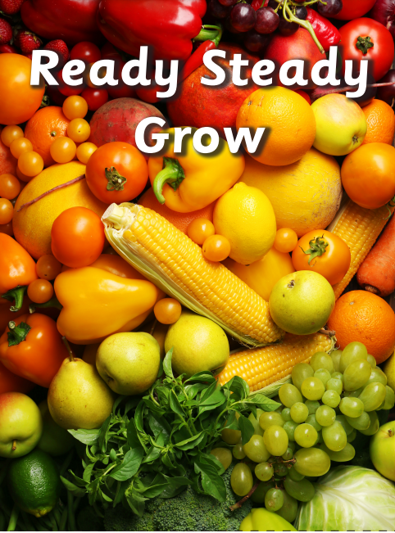
Mathematics
In maths we will compare length and height and then move on to learning about the composition of 10, number bonds to 10 and doubling numbers to 10.
Physical Development
In our PE lesson every Friday Mr Slaney we will be focusing on dance.
Literacy
This half term we will be reading ‘Jack and the beanstalk’. Once we know the story really well we will rewrite it making sure we use story language, and key sentnece openers ‘First’, ‘Next’ ‘Finally’
In phonics we will review the Phase 3 sounds already learnt and practice reading and writing longer words with these sounds in.
We will continue reading our Little Wandle reading books in school and these will be sent home every Friday for your child to read with you at home.
Our florist and farm shop role play areas will provide children with the opportunity to practice and extend their vocabulary and oracy skills as they take on different roles.
Forest school
We will continue to visit forest school every Friday where we will look for signs of spring and build bird nests after a spot of bird watching.
Our topic in Hedgehogs Class for this half term is ‘Ready, Steady, Grow’. During this topic we will learn about food and farming and explore themes, including where food comes from, what plants and animals need to grow and survive and what constitutes a healthy lifestyle.
Understanding the World
Over the coming weeks we will be sowing vegetable and plant seeds and taking care of them as they grow. We will also be
thinking about where our food comes from, what it looks, tastes and smells like.
Personal, Social and Emotional Development
During our PSED sessions we will be thinking about our bodies and growing up. We will describe our appearance and name some body parts, discuss how we look after our body and keep it clean, and think about how we feel about growing up
Expressive Arts and Design
We will be looking at the painting ‘The Fruit Bowl’ by the artist Giuseppe Arcimboldo as inspiration for creating our own art work. We will also listen to the piece of music ‘Spring’ by the composer Vivaldi and create our own spring art.
R.E.
Our big question in R.E. this half term is ‘Why is Easter special to Christians? We will join in with the Easer church service towards the end of the term

