Slide 1
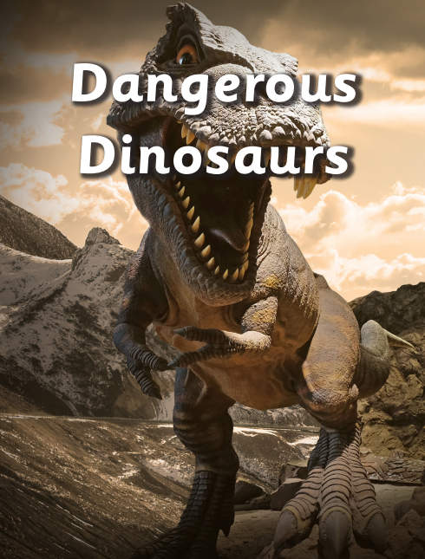
Personal, Social and Emotional Development
This half term we will be thinking about ‘My body and growing up’. This will include exploring how I can look after my body and keep it clean.
Literacy
In our phonics lessons we will consolidate our phonic knowledge and practice reading longer words. As the term progresses we will begin to learn some new tricky words which will be sent home for you to practice with your child, During our mark making and writing sessions we will focus on applying our phonic knowledge to writing longer sentences and reinforce the use of capital letters, full stops and finger spaces. We will also practice reading and writing the tricky words we have been learning.
In reading we will continue to follow the Little Wandle scheme to deliver daily group reading sessions, that allow the children to practice decoding words, reading with expression and developing comprehension.
During our daily story time sessions and literacy inputs we will be reading a selection of fiction and non fiction books including ‘The girl and the dinosaur’, ‘Cave baby’ and ‘Dear dinosaur’
Physical Development
In our PE lesson every Friday with Mr Slaney we will begin our Dance unit , We will also continue with our swimming lessons on Tuesday afternoons at Loughborough Leisure Centre.
Mathematics
In our maths lessons this half term we will begin with exploring length and height before we deepen our understanding of numbers 9 and 10 and moving on to looking at doubles and bonds to 10. We will also have the opportunity to explore 3D shape before the end of the term.
Expressive Arts and Design
This half term we will have fun creating dinosaur eggs and volcanoes with paper mâché as well as creating our own mini dinosaur small worlds . We will learn songs about abut spring and Easter ready to perform at our Easter church service.
R.E.
Our big question in RE this half term is ‘Why do Christians put a cross on their Easter gardens?’ In thinking about this question we will consider the importance of Easter for Christians.
Understanding the World
Over the coming weeks we will learn about the dinosaurs that roamed the earth millions of years ago and the difference between herbivores and carnivores. We will look at fossils and try to make some of our own. Towards the end of the term we will look at the weather, seasonal changes and think about spring and look for signs of it around the school grounds.
Our topic in the Hedgehog class this half term is ‘Dangerous Dinosaurs’ This exciting project teaches children about the different animals that roamed Earth millions of years ago and how they are related to animals that live on Earth today
Forest school
During our regular Friday afternoon forest school session we will be looking for signs of spring, as well as creating our own dinosaur nests with natural materials.

